Slide 1
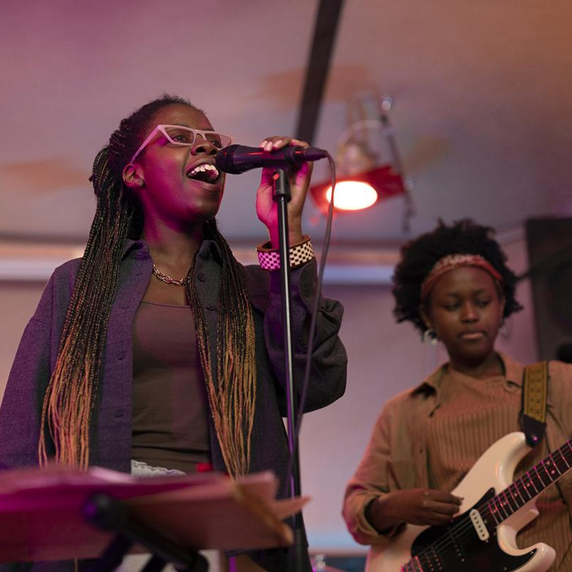
Music Recommendation by Image
ToBig’s
14th
Conference
Recommendation
김종우, 나다경, 염제윤, 이지수
Recommendation

Slide 2



ToBig’s
14th
Conference
Recommendation
Result
https://github.com/emforce77/tobigs_conference_14_rec
Recommendation

Slide 3

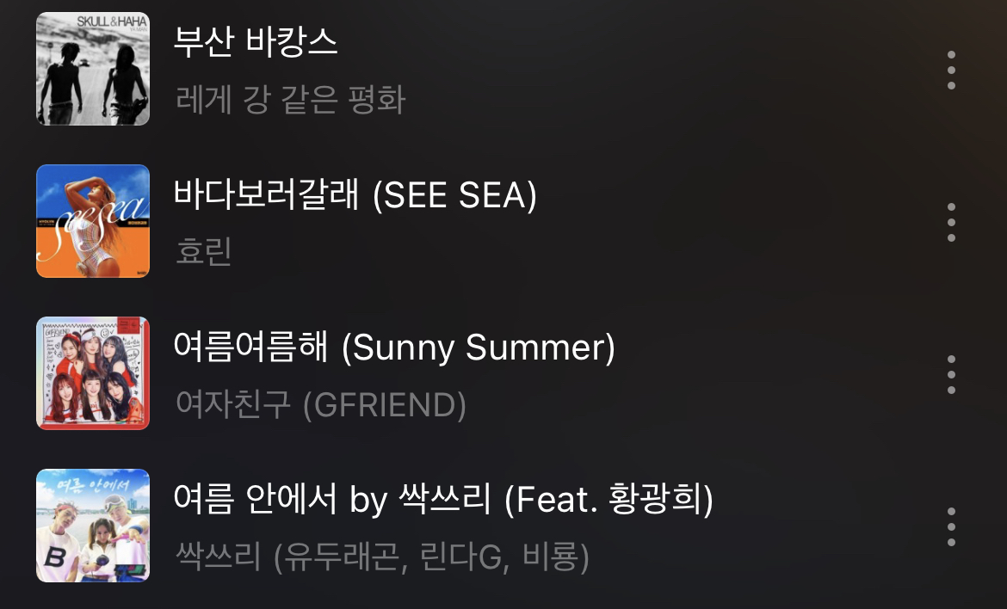

Motivation
Data
Modeling
Result
이미지의 분위기와 유사한 노래 추천
Motivation

Slide 4
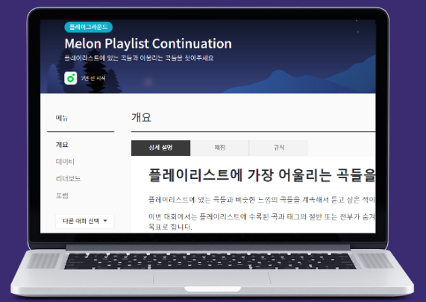
Motivation
Data
Modeling
Result
Kakao Arena Melon playlist continuation
약 20만개의 Tag, playlist dataset
약 60만개의 Song dataset
- song_meta, mel_data, playlist_meta
Used Data

Slide 5
Motivation
Data
Modeling
Result
Song_meta
곡 제목, 앨범 제목, 아티스트명,장르,발매일
Arena_mel
곡에 대한 mel-spectrogram을 담고있는 파일
Playlist_meta
제목, 플레이리스트에 수록된 곡, 태그 목록
Used Data

Slide 6
Motivation
Data
Modeling
Result
Overall Framework
Music Recommendation
Image Captioning
Embedding
Service Flow

Slide 7
Motivation
Data
Modeling
Result
Overall Framework
Inference pre-trained model
Music Recommendation
Image Captioning
Embedding
Service Flow

Slide 8
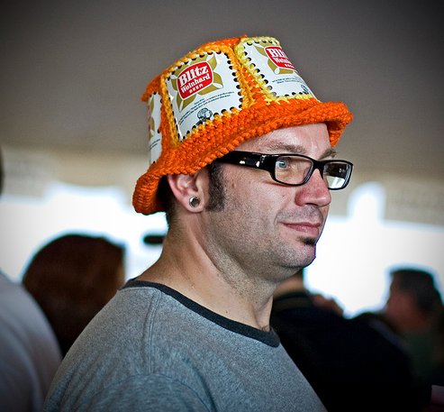
Motivation
Data
Modeling
Result
Image captioning
model
Cross-Entropy
Dense(8254)
LSTM(512)
LSTM(128)
Concatenate
Time_Distributed
Dense(128)
LSTM(256)
A man in an orange hat starring at something.
A man wears an orange hat and glasses.
A man with gauges and glasses is wearing a Blitz hat.
A man with glasses is wearing a beer can crocheted hat.
The man with pierced ears is wearing glasses and an orange hat.
ResNet50
Embedding
Image
Caption
Modeling

Slide 9
Motivation
Data
Modeling
Result
Image captioning
model
perdict
Cross-Entropy
Dense(8254)
LSTM(512)
LSTM(128)
Concatenate
Time_Distributed
A man and a woman are standing on the beach .
Dense(128)
LSTM(256)
ResNet50
Embedding
남자와 여자가 해변에 서있다.
Image
Caption
남자, 여자, 해변
Modeling

Slide 10
Motivation
Data
Modeling
Result
Overall Framework
Train Recommendation model
Music Recommendation
Image Captioning
Embedding
Service Flow

Slide 11
Motivation
Data
Modeling
Result
Input Data (define label)
Tag A
Mel-spectrogram A
100%의 similarity를 가지는 것으로 가정
Tag B
Mel-spectrogram B
Tag A
Mel-spectrogram A
Tag A와 Tag B의 similarity를 계산
Tag B
Mel-spectrogram B
Tag A
Mel-spectrogram A
Tag A와 Mel-spectrogram B의
similarity로 가정
Tag B
Mel-spectrogram B
Input Data

Slide 12
Motivation
Data
Modeling
Result
Predict
Similarity
Recommendation
model
Dot Product
Tag Feature
Song Feature
Dropout (0.2)
Dense (16)
Batch Normalization
…
Dense (16)
Dropout (0.2)
Batch Normalization
Dropout (0.2)
Dense (32)
Batch Normalization
Dense (256)
Dropout (0.2)
Batch Normalization
Concatenate
Dense (64)
Dropout (0.2)
LSTM
Batch Normalization
Dense (128)
MaxPooling 2D
One-hot encoding
Flatten
Dropout (0.2)
Dropout (0.2)
Batch Normalization
Batch Normalization
Conv 2D (128)
Dense (256)
…
Conv 2D (128)
Kobert
MaxPooling 2D
Embedding
Dropout (0.2)
Batch Normalization
Conv 2D (32)
Conv 2D (32)
Tag
Mel-spectrogram
Genre
Singer
Modeling

Slide 13
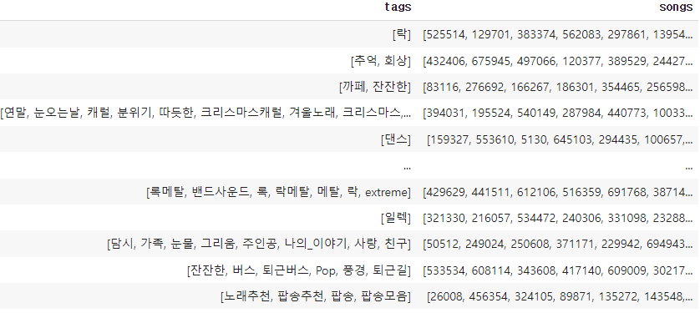
Motivation
Data
Modeling
Result
Recommendation
model
Input data
Tag Feature
Dense (16)
Dropout (0.2)
Batch Normalization
Dense (32)
Dropout (0.2)
Batch Normalization
Dense (64)
Dropout (0.2)
Batch Normalization
Dense (128)
TAG
English to Korean
Extract Noun and Adjective
Dropout (0.2)
Batch Normalization
Dense (256)
Kobert
Processing
- 노래A가 포함된 Playlist들의 Tag의 embedding 추출 후
average를 Tag A embedding으로 정의
Embedding
- Kobert-small (256-d)를 사용
Tag
Modeling

Slide 14
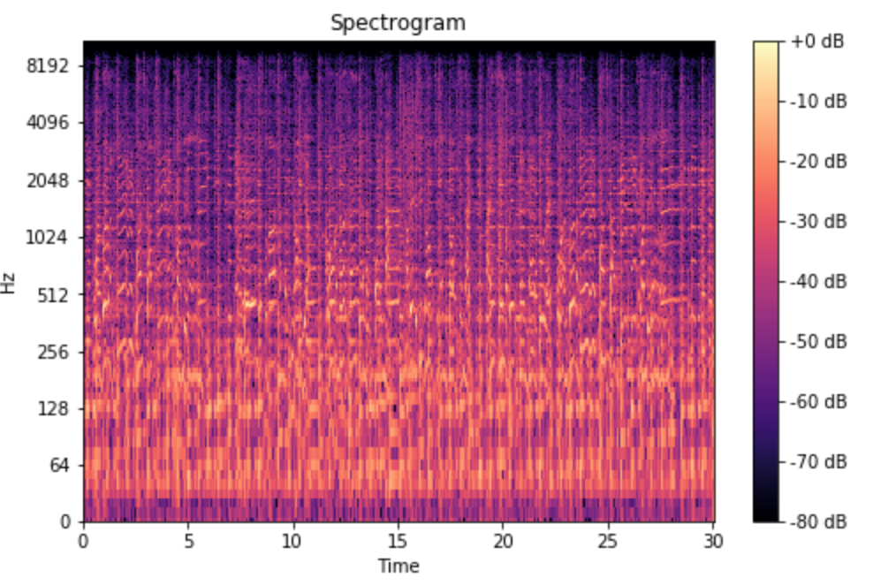
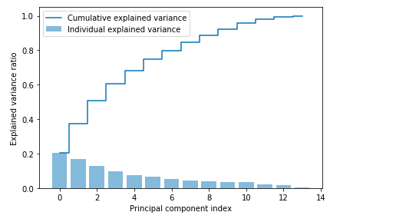
Motivation
Data
Modeling
Result
Recommendation
model
Input data
Mel
spectrogram
48x1892 48x20
LSTM
240GB 2GB
MaxPooling 2D
Dropout (0.2)
Batch Normalization
Conv 2D (128)
…
Conv 2D (128)
MaxPooling 2D
Dropout (0.2)
Batch Normalization
Conv 2D (32)
About 85%
Explained Variance
Conv 2D (32)
CNN을 통해 feature extract
Mel-spectrogram
Modeling

Slide 15
Motivation
Data
Modeling
Result
Predict
Similarity
Recommendation
model
Dot Product
Tag Feature
Song Feature
Dropout (0.2)
Dense (16)
Batch Normalization
Dense (16)
…
Dropout (0.2)
Batch Normalization
Dropout (0.2)
Dense (32)
Batch Normalization
Dense (256)
Dropout (0.2)
Batch Normalization
Concatenate
Dense (64)
Dropout (0.2)
LSTM
Batch Normalization
Dense (128)
MaxPooling 2D
One-hot encoding
Flatten
Dropout (0.2)
Dropout (0.2)
Batch Normalization
Batch Normalization
Conv 2D (128)
Squeeze
Net
Dense (256)
…
Conv 2D (128)
Kobert
MaxPooling 2D
Embedding
Dropout (0.2)
Batch Normalization
Conv 2D (32)
Conv 2D (32)
Tag
Mel-spectrogram
Genre
Singer
Modeling

Slide 16
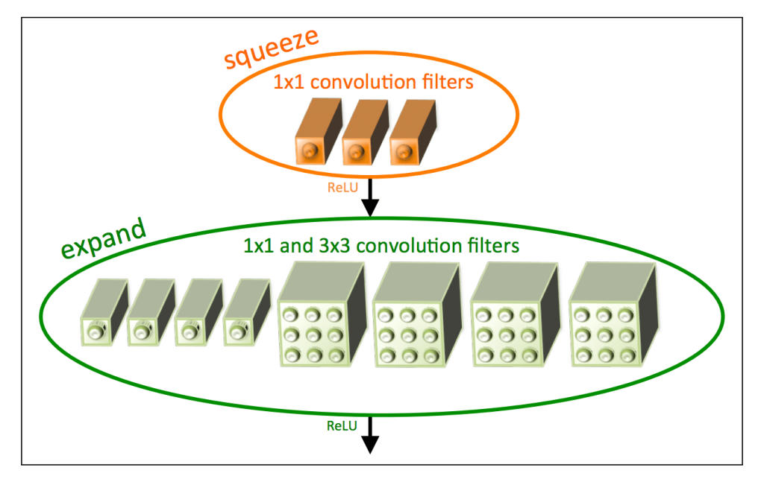
Motivation
Data
Modeling
Result
Predict
Similarity
Song
Recommendation
Model
fire1
Dot Product
MaxPooling2D
Tag Feature
Song Feature
Dropout (0.2)
Dense (16)
Batch Normalization
fire2
Dense (16)
…
Dropout (0.2)
MaxPooling2D
Batch Normalization
Dropout (0.2)
Dense (32)
Batch Normalization
Dense (256)
Dropout (0.2)
fire3
Batch Normalization
Concatenate
Dense (64)
MaxPooling2D
Dropout (0.2)
LSTM
Batch Normalization
Dense (128)
MaxPooling 2D
One-hot encoding
Flatten
fire4
Dropout (0.2)
Dropout (0.2)
Squeeze
Net
Batch Normalization
Batch Normalization
Conv 2D (128)
Dense (256)
…
MaxPooling2D
Conv 2D (128)
Kobert
MaxPooling 2D
Embedding
fire5
Dropout (0.2)
Batch Normalization
Conv 2D (32)
Conv 2D (32)
Tag
Mel-spectrogram
Genre
Singer
Modeling

Slide 17
Motivation
Data
Modeling
Result
Predict
Similarity
Song
Recommendation
Model
Dot Product
Tag Feature
Song Feature
Dropout (0.2)
Dense (16)
Batch Normalization
Dense (16)
…
Dropout (0.2)
Batch Normalization
Dropout (0.2)
Dense (32)
Batch Normalization
Dense (256)
MSE | nDCG | Kendall's τ
0.0083 | 0.99 | 0.4075
Dropout (0.2)
Batch Normalization
Concatenate
Dense (64)
Dropout (0.2)
LSTM
Batch Normalization
Dense (128)
MaxPooling 2D
One-hot encoding
Flatten
Dropout (0.2)
Dropout (0.2)
Squeeze
Net
Batch Normalization
Batch Normalization
Conv 2D (128)
Dense (256)
…
Conv 2D (128)
Kobert
MaxPooling 2D
Embedding
Dropout (0.2)
Batch Normalization
Conv 2D (32)
Conv 2D (32)
Tag
Mel-spectrogram
Genre
Singer
Modeling

Slide 18
Motivation
Data
Modeling
Result
Song_name | Artist_name
Over The Rainbow | Karel Boehlee Trio
다시 여기 바닷가 | 싹쓰리
Summer Feelings | Lennon stella
Sanctify | Years & Years, Alma
Lie About Us | Avant
해변, 남자, 여자, …
로맨틱, 밝음
Result

Slide 19
Incomplete Mel Data
Lack of Captioning
Adjective
Incomplete Metric
Lack of Infra
Motivation
Data
Modeling
Result
Limitation
Mel-spectrogram이 곡의
일부만을 갖고 있음.
캡셔닝 결과 감정형용사의 부족
불완전한 성능지표
전반적인 자원 부족
Restriction
Notes:
감정 형용사 부족 → 실제 PREDICTION 할때 형용사 넣어서 했다(보완)
+) 성능지표 이야기 (abtest….)

Slide 20
Complete Mel-Data
Adding More Data
Motivation
Data
Modeling
Result
Improvement
전체 곡 데이터를 적용
곡 관련 데이터 추가
Improvement
Notes:
감정 형용사 부족 → 실제 PREDICTION 할때 형용사 넣어서 했다(보완)

Slide 21
Motivation
Data
Modeling
Result
Reference
Image Captioning DataSet : Flicker8ksau
https://www.kaggle.com/datasets/waelboussbat/flickr8ksau
Kakao Arena Melon-data
https://arena.kakao.com/c/7
Deep Convolutional and LSTM Neural Networks for Acoustic Modelling in Automatic Speech Recognition
http://cs231n.stanford.edu/reports/2017/pdfs/804.pdf
SqueezeNet: AlexNet-level accuracy with 50x fewer parameters and <0.5MB model size, Forreset N. landola et al, ICLR2017
https://arxiv.org/abs/1602.07360
Reference

Slide 22



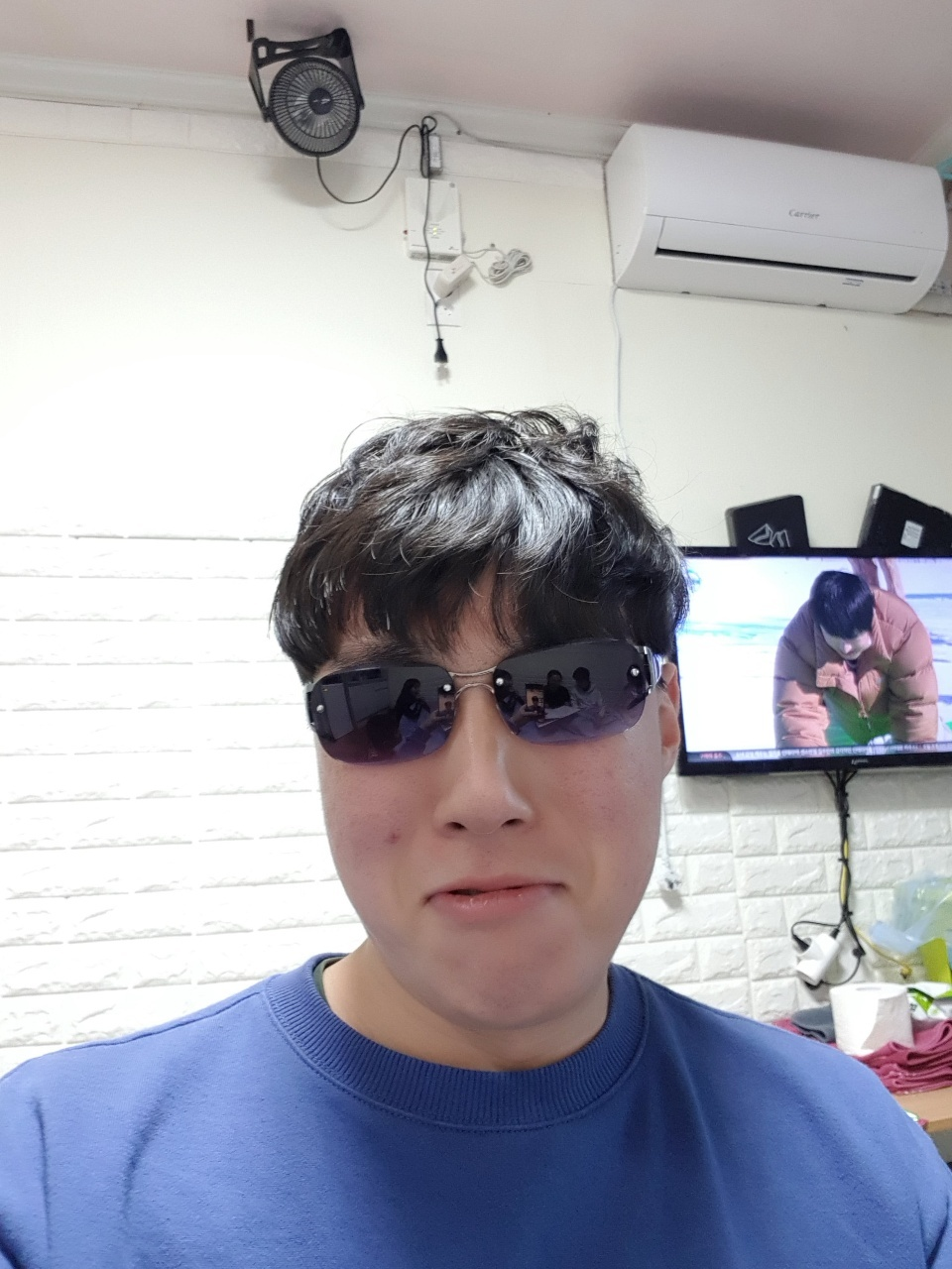

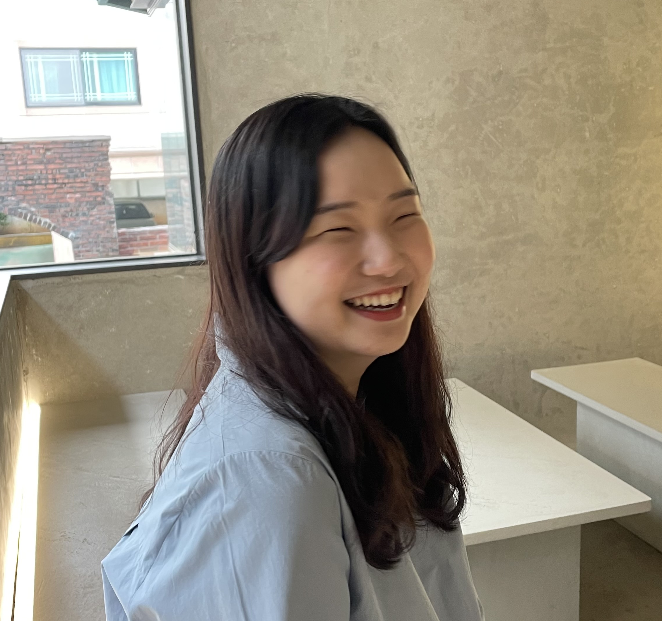
Motivation
Data
Modeling
Result
17기 염제윤
16기 김종우
17기 나다경
17기 이지수
KINGKINGKINGKING
KINGKINGKING
KING
내 mbti는 C.U.T.E
최고의 엔딩 고양이 집사
음악이랑 거리두기 3단계
Our Team

Slide 23
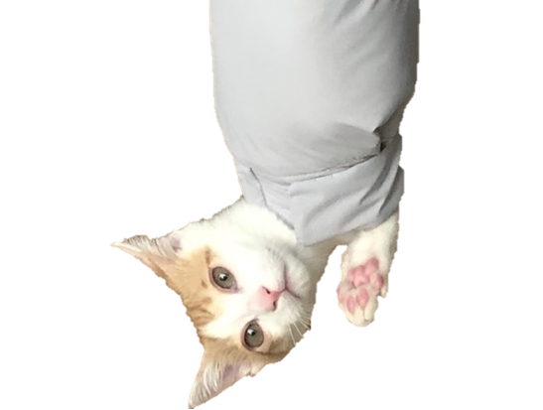
Motivation
Data
Modeling
Result
THANK YOU
Thank U

